Slide 1
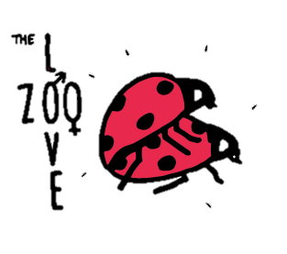
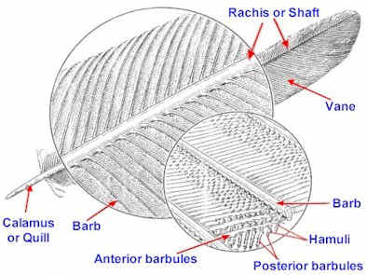
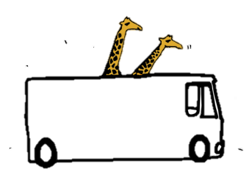
arts of a feather
P
Make your own head-dress!

Slide 2
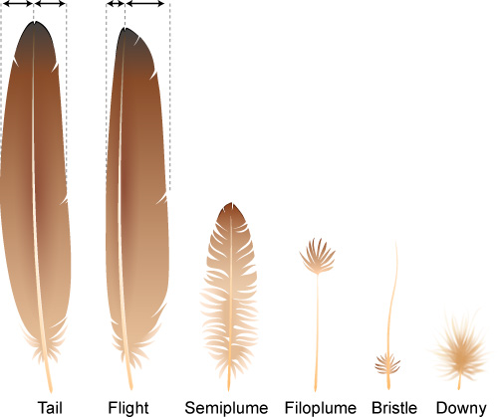
F
eathers
Contour Feathers give the bird its characteristic smooth round shape. They also give the bird its visual coloring and provide a first level of defense against physical objects, sunlight, wind and rain. They are very important.
Down Feathers are smaller and lack the barbules and their accompanying hooklets so they are not zipped together and do not look as neat. In fact they are soft and fluffy. They provide most of the insulation and are so good at this that mankind for many years collected down feathers from various birds to put into sleeping bags and jackets to help keep us warm.
Semiplumes are half-way between a contour feather and a down feather. These occur between the contour feathers and help to supply insulation and a certain amount of form as well.
Filoplumes are very small and have only a very few barbs at their tips. They are believed to have a sensory function, helping birds keep their feathers in order.
Make your own head-dress!

Slide 3
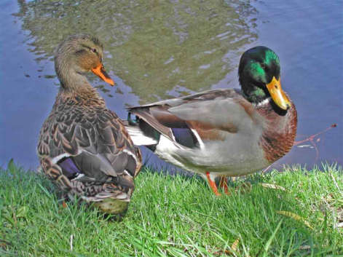
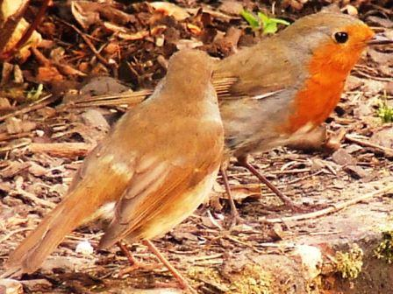
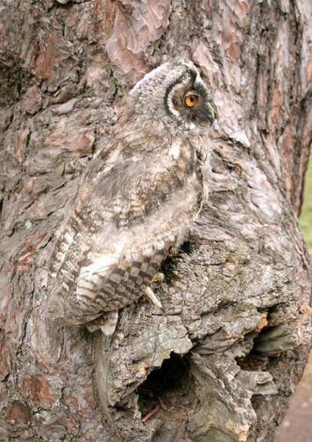
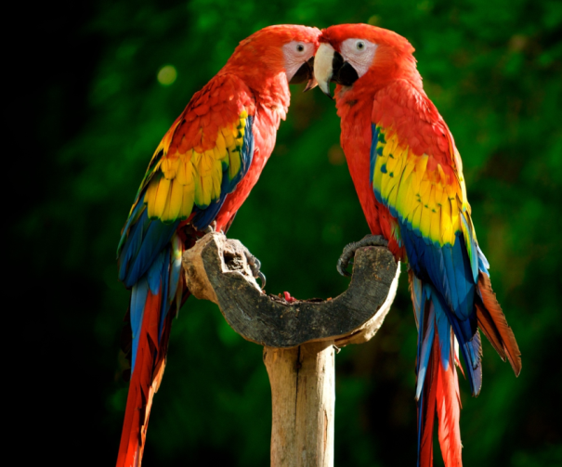
rightly coloured birds
B
Make your own head-dress!

Slide 4
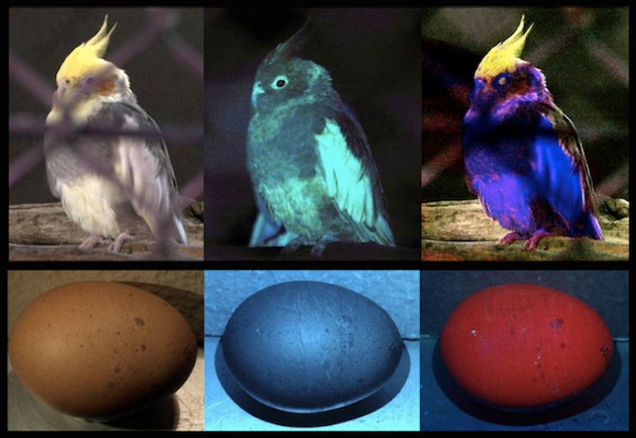
ow birds see – in UV!
H
Human
Bee
Bird
Dr Klaus Schmitt, Germany
Make your own head-dress!

