Slide 1
UK freshwater species quiz
Notes:
Many of the answers to these questions can be found in the Biology Week poll school resources pack: https://www.rsb.org.uk/get-involved/biologyweek/uk-s-favourite-freshwater-species
Answers to each question are in the slide notes! The content is suitable for 13 to 15 year olds.

Slide 2
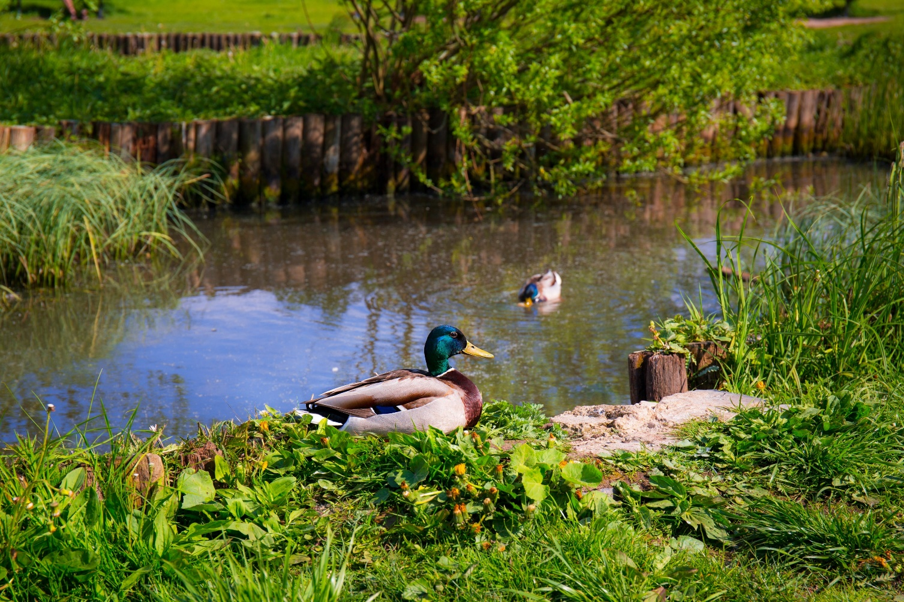
Question 1.
Which of the following is not a freshwater source?
Ditch
Ocean
Canal
Lake
Notes:
A: b) the ocean

Slide 3
Question 2.
Roughly how much of the Earth’s surface is covered by freshwater?
Half
Two thirds
Quarter
Notes:
Answer: two thirds (71% to be exact)

Slide 4
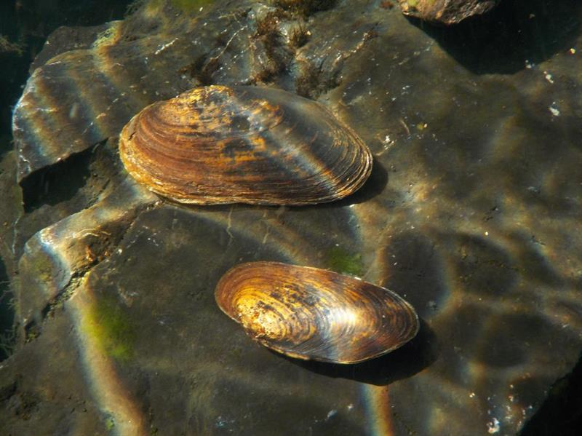
Question 3.
What is the term given to animals without a backbone?
Notes:
Answer: Invertebrates

Slide 5
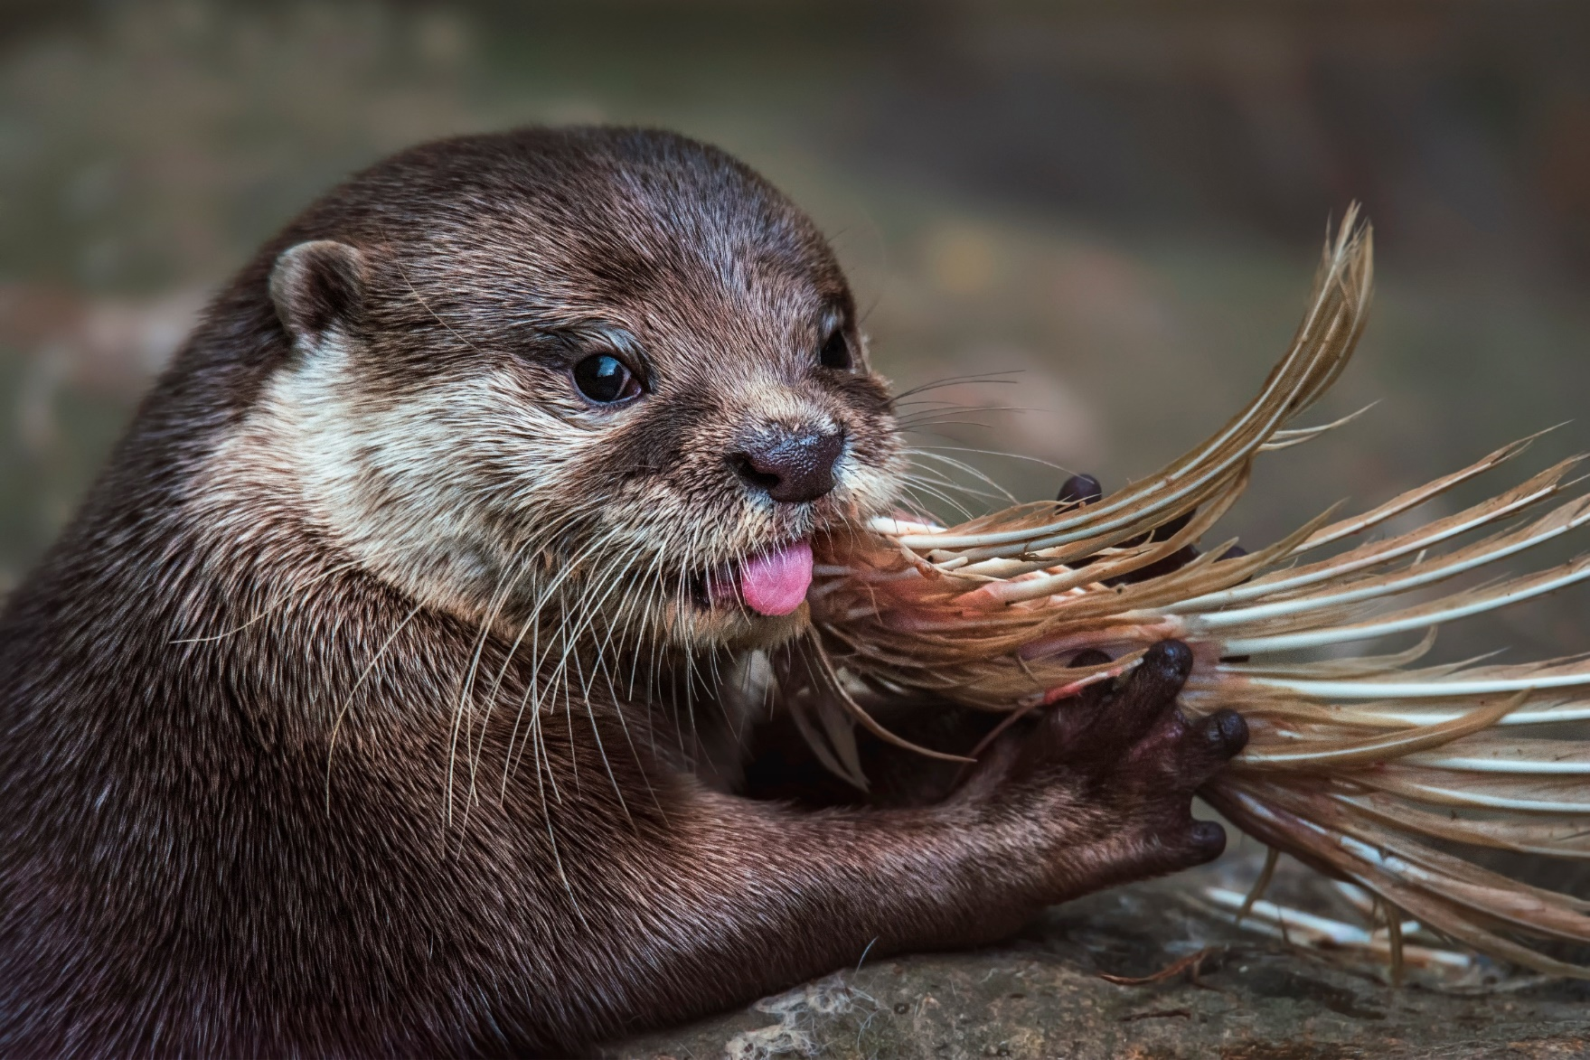
Question 4.
What group of animals do otters belong?
Notes:
Answer: mammals

Slide 6
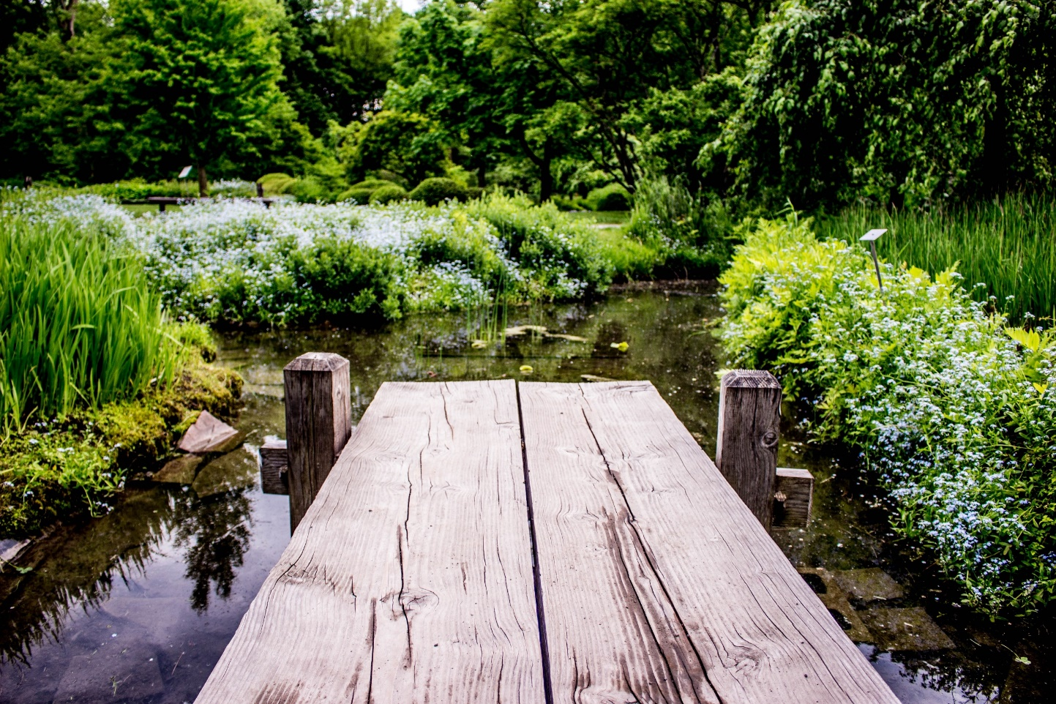
Question 5.
What is the name of the process in the water cycle that returns water from clouds to the ground?
Condensation
Evaporation
Transpiration
Precipitation
Evapotranspiration
Notes:
Answer: d) Precipitation

Slide 7
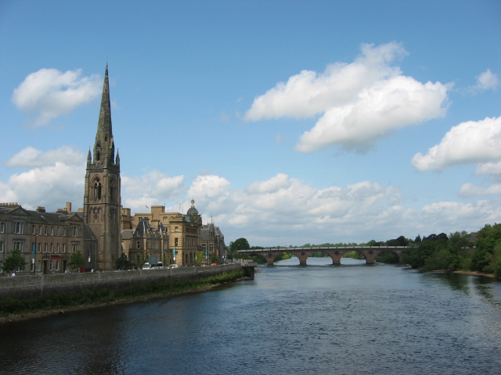
Question 6.
Which is the longest river in the UK?
Severn
Thames
Nene
Tay
Wye
Notes:
Answer: River Severn, which is 220 miles long

Slide 8
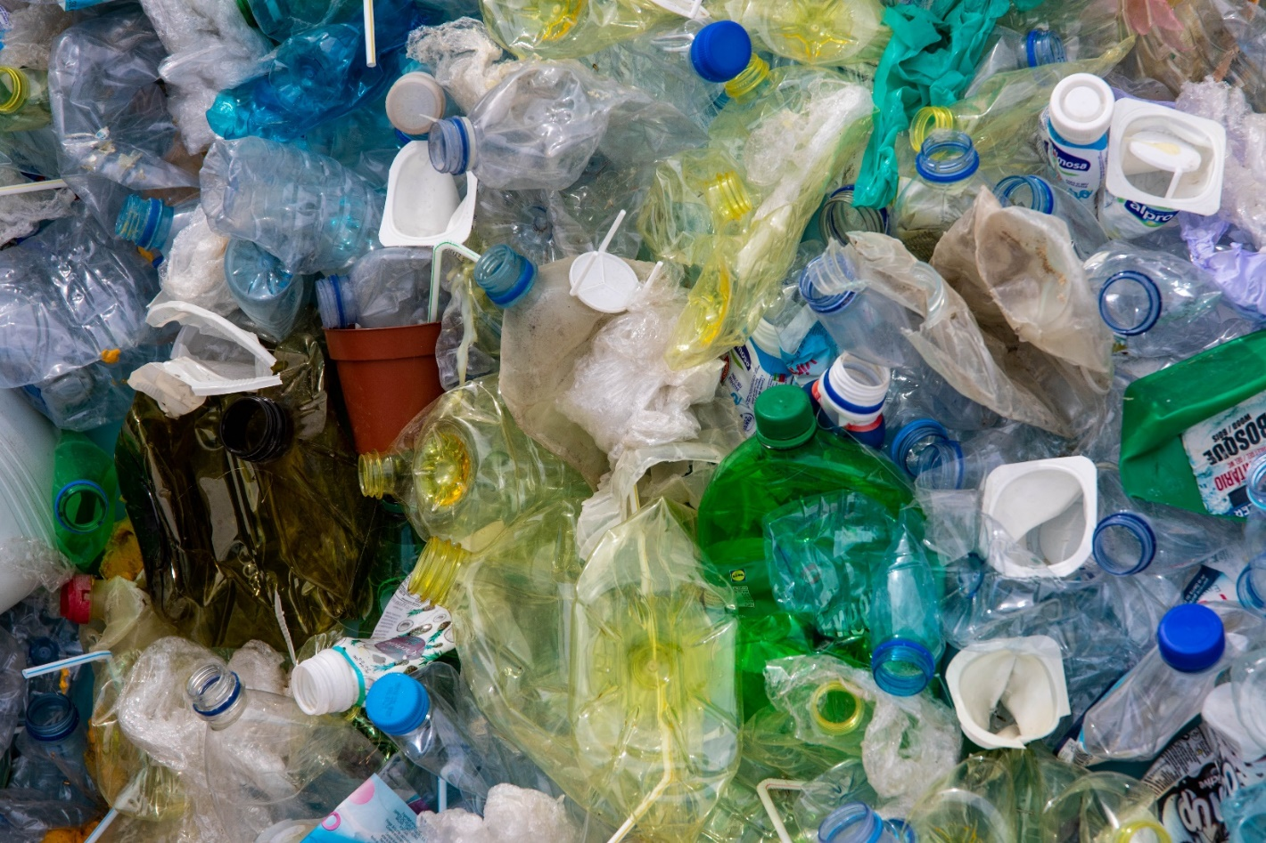
Question 7.
What percentage of rivers and canals are considered to be in poor or bad condition?
75%
83%
91%
69%
Notes:
Answer: d) 69%

Slide 9
Question 8.
How old was the oldest freshwater pearl mussel?
112 years old
134 years old
156 years old
220 years old
Notes:
Answer: b) 134 years old

Slide 10
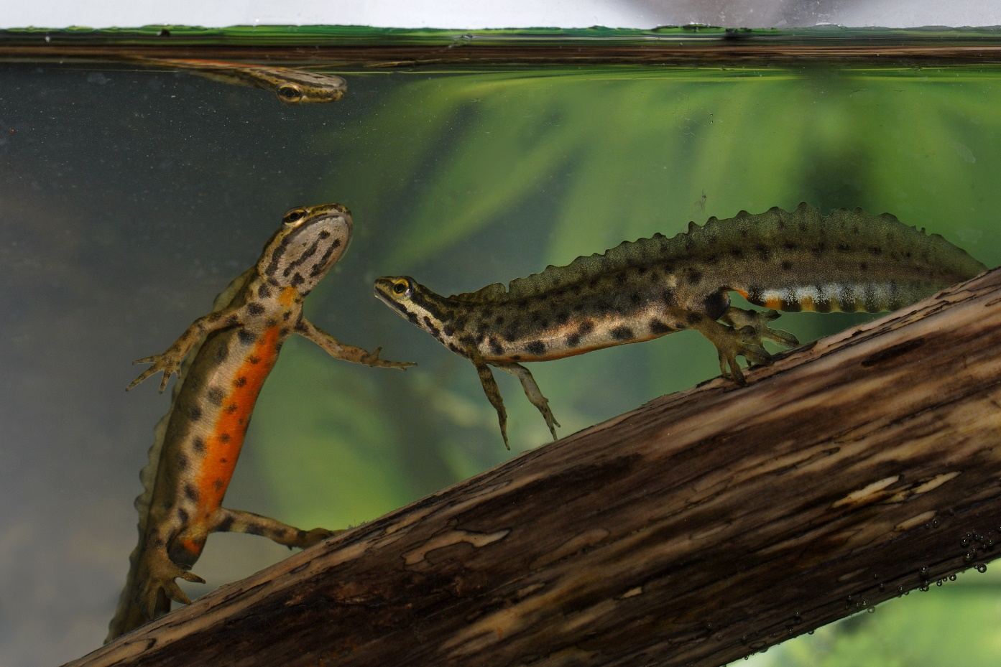
Question 9.
At what time of day are smooth newts most active?
Daytime
Night time
Notes:
Answer: b) Night time

Slide 11
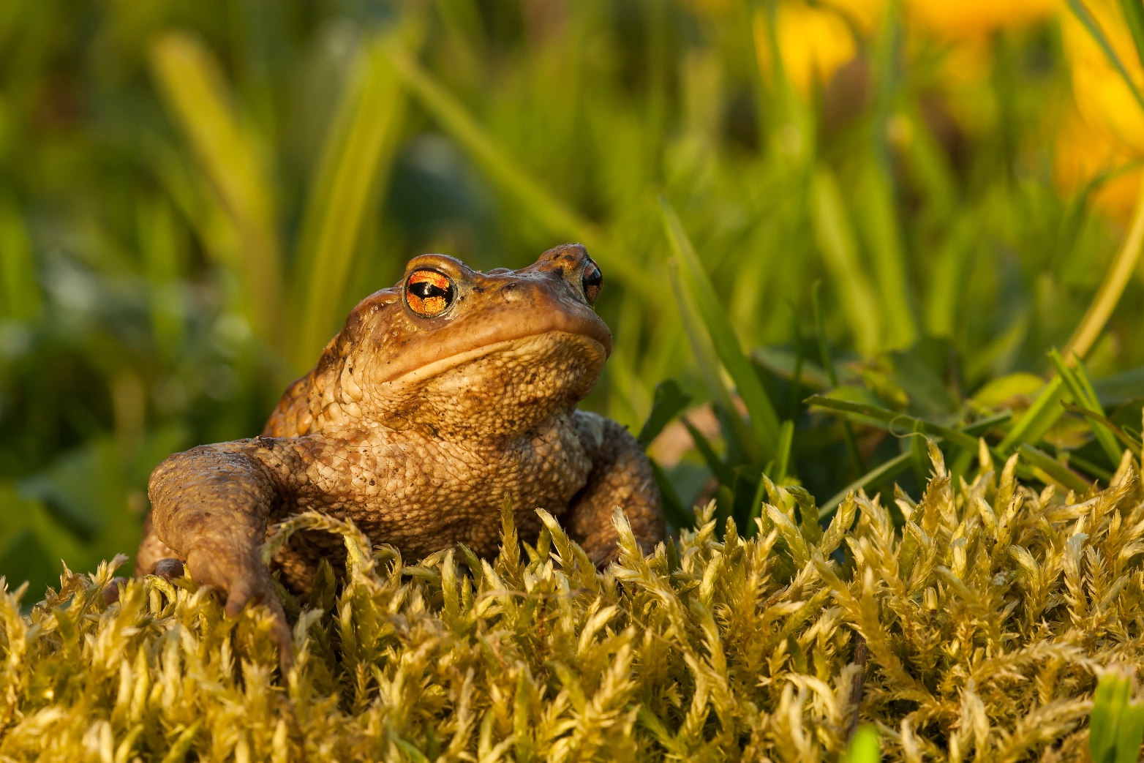
Question 10.
What is the Latin name for the common toad?
Bufo elegans
Bufo bufo
Margaritifera margaritifera
Myxas glutinosa
Notes:
Answer: b) Bufo bufo

Slide 12
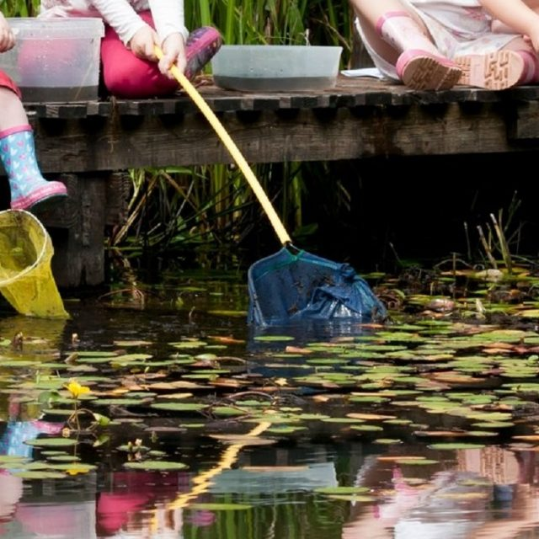
Question 11.
The Norfolk hawker is a species of what insect?
Frog
Mussel
Dragonfly
Flower
Notes:
Answer: c) Dragonfly

Slide 13
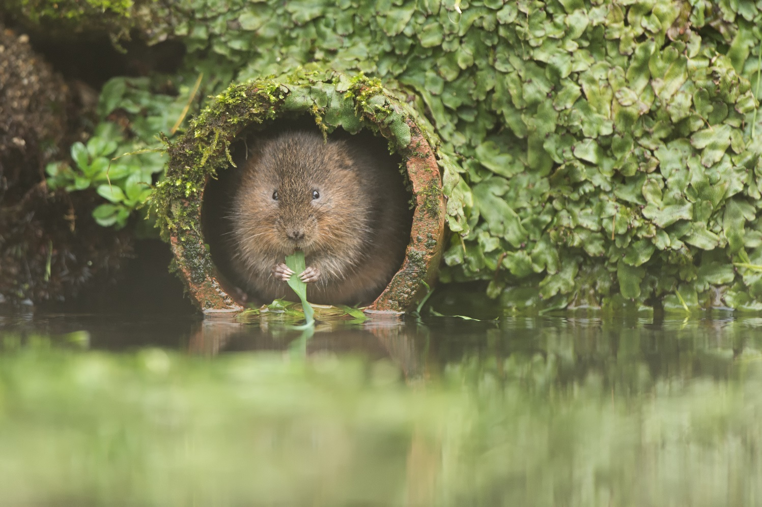
Question 12.
How heavy should a vole be to survive the winter?
160g
190g
210g
170g
Notes:
Answer: d) 170g

Slide 14
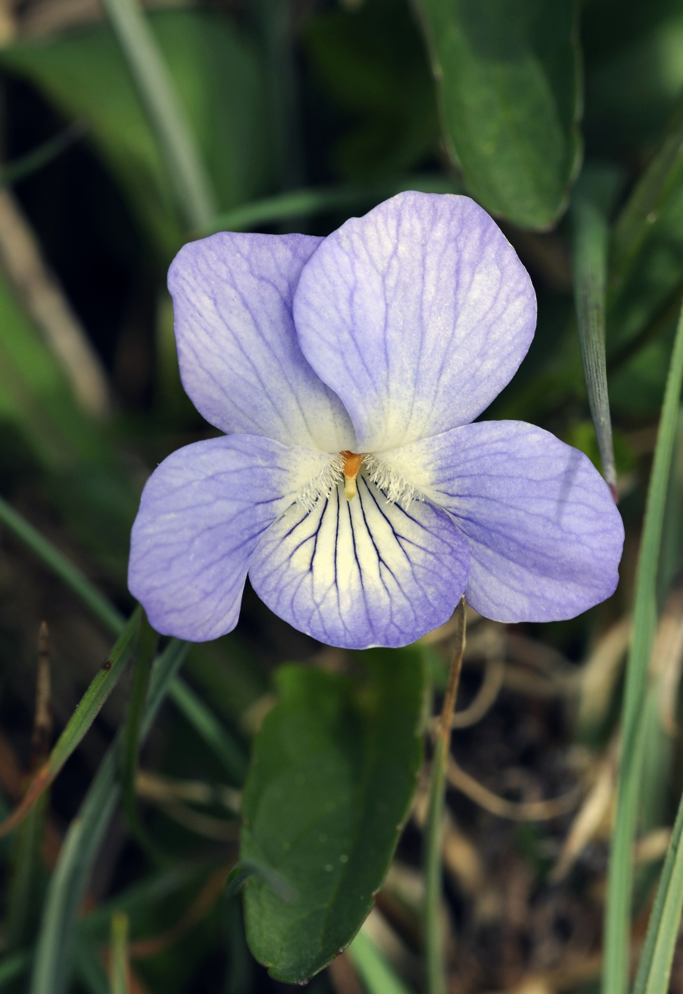
Question 13.
What environment does the fen violet prefer?
Deep rivers
Dry riverbanks
Wheat fields
Peat marshes
Notes:
Answer: d) Peat Marshes

Slide 15
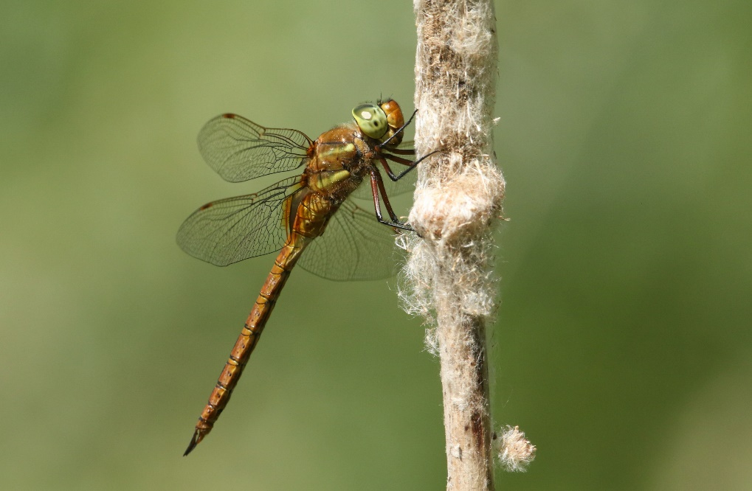
Question 14.
Which freshwater habitat do the organisms pictured share?
Ponds
Lake
River
Canal
Notes:
Answer: a) Ponds

Slide 16
Freshwater sources word search
Using information from the quiz, print out, and then complete the word search on the next slide.

Slide 17
G | L | N | V | W | J | R | Q | L | F | E | M | X | L | W
R | P | G | Z | S | M | K | D | O | L | O | N | S | N | J
H | N | P | H | N | Y | X | W | C | X | R | S | E | O | U
R | E | V | I | R | F | U | Y | L | T | T | N | N | B | P
L | G | M | P | G | C | C | W | Z | I | S | L | A | K | E
D | X | H | J | X | R | Q | F | K | M | X | I | U | R | P
H | O | X | Q | E | X | S | T | C | U | F | Y | M | I | S
C | I | U | T | X | T | S | C | U | Z | Y | I | D | R | O
G | G | A | L | R | H | A | E | G | I | A | N | N | A | G
X | W | V | E | Z | N | H | Y | R | P | E | D | O | I | W
O | Y | A | Y | A | C | Z | R | V | I | L | M | P | N | U
F | M | U | L | T | T | G | T | H | Q | F | Q | P | W | L
E | K | C | I | U | G | I | V | G | C | P | W | B | U | P
I | H | D | T | M | V | U | W | G | I | L | S | V | O | W
E | O | G | R | A | K | O | N | A | C | T | N | W | W | O
---- = I stay in one place, but I am smaller than a lake
---- =I am completely surrounded by land
----- = I am found on every continent and I can flow for miles
------- = I am similar to a river, but slightly smaller
----- = I am a groove or hole in the ground in which water may collect
---------- = I recycle freshwater through my different processes
----- = You’ll find me connecting cities and towns, I am man made
---- = I return water to the ground from the clouds
---- = I form from very cold rain
---- = I collect near the ground when it is cold, often early in the morning or late at night
Notes:
Pond
I stay in one place, but I am smaller than a lake
Lake
I am completely surrounded by land
River
I am found on every continent and I can flow for miles
Stream
I am similar to a river, but am slightly smaller
Ditch
I am a groove or hole in the ground in which water may collect
Water cycle
I recycle freshwater through my different processes
Canal
You’ll find me connecting cities and towns, I am man made
Rain
I return water to the ground from the clouds
Snow
I form from very cold rain
Mist
I collect near the ground when it is cold, often early in the morning or late at night

Slide 18
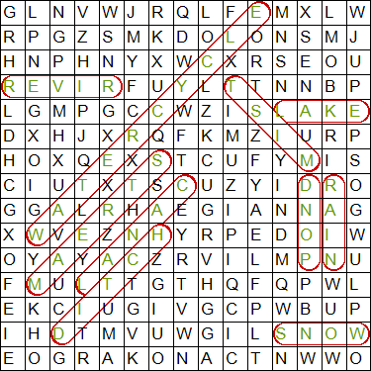

Slide 19
14
How did you do?
Follow us on Twitter @RoyalSocBio using the hashtag #BiologyWeek to let us know!
Find us on Facebook too!
Love biology? Interested in becoming a member?
Email membership@rsb.org.uk
Thank you for helping us celebrate Biology Week 2019!

