Slide 1
Biology Week 2015 Quiz Questions
Ages 16-18
Points shown in ( )

Slide 2
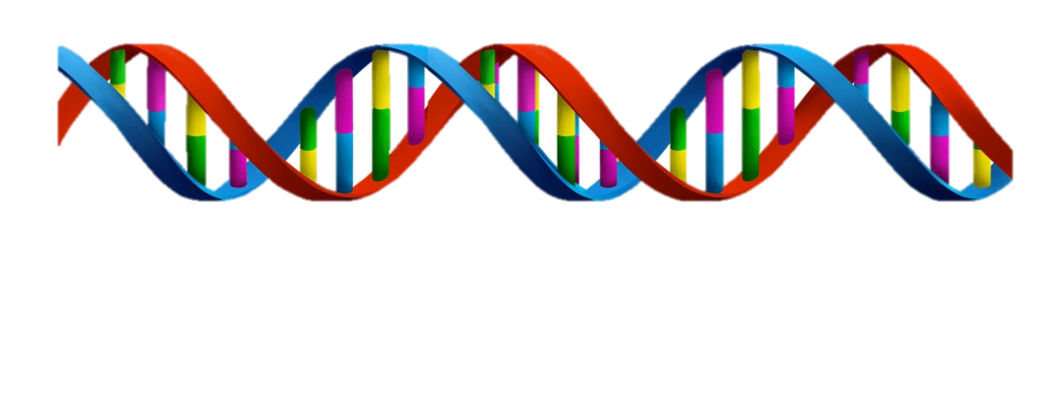
Question 1
(2)
Who discovered the structure of DNA?
Contributed by the Biochemical Society

Slide 3
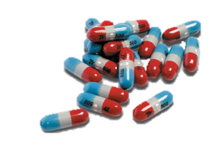
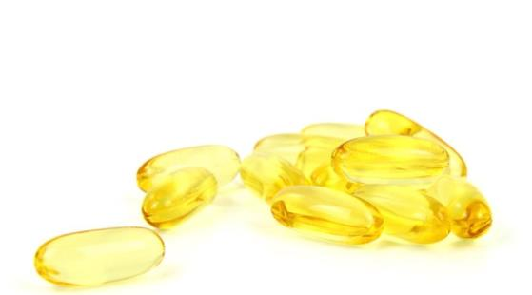
Question 2
(1)
Which of the following vitamins can be made in the skin?
Vitamin C
Vitamin D
Vitamin K
Vitamin E
Vitamin B

Slide 4
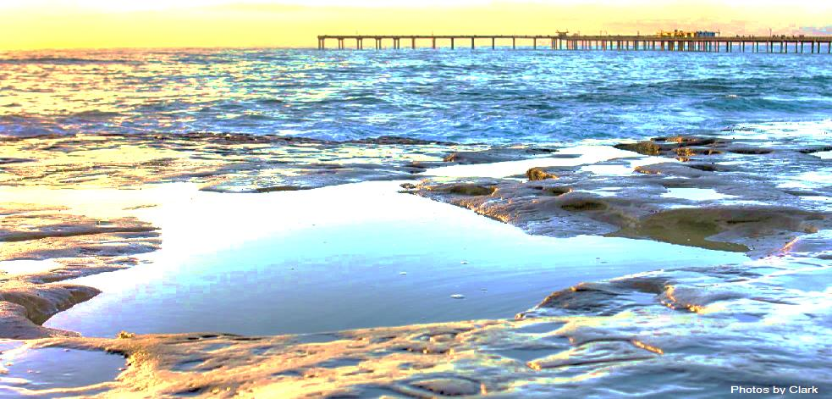
Question 3
(1)
Why is the sea blue?
Contributed by the Marine Biological Association

Slide 5
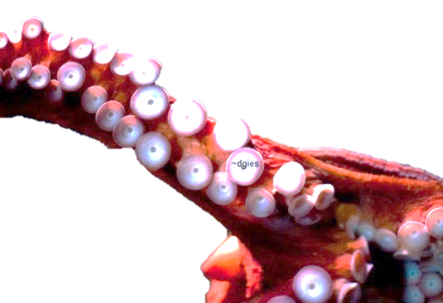
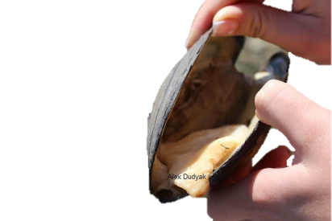
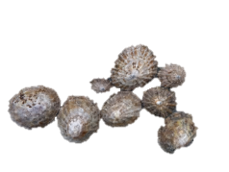
Question 4
(1)
Which mollusc species holds the record for containing the strongest natural substance known to man?
Limpet
Octopus
Mussel
Contributed by the Marine Biological Association

Slide 6
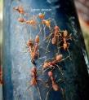
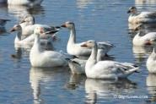
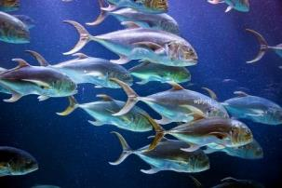
Question 5
(5)
A shoal of fish… a gaggle of geese… a colony of ants… Name the following animal groups:
A … of rhinoceroses
A … of owls
A … of porcupines
A … of mice
A … of bears

Slide 7
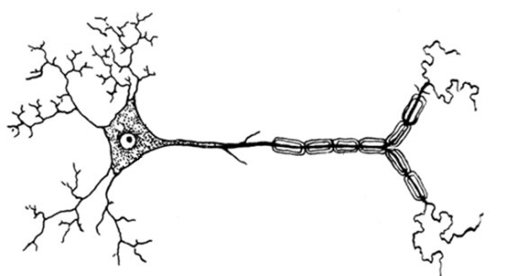
Neurones transmit electrical signals all over our bodies in order to help us react to our environment. Label the diagram of the motor neurone below:
Question 6
(6)
Cell body
Axon
Myelin sheath
Dendrite
Node of Ranvier
Nucleus

Slide 8
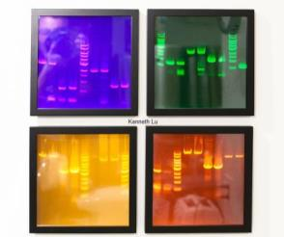
Question 7
(2)
Gel electrophoresis is used to separate and purify strands of DNA.
The rate at which DNA migrates through the agarose gel is determined by which of the following two factors:
The molecular size of the DNA
The agarose gel concentration
The negativity charge of the DNA
The length of the agarose gel

Slide 9
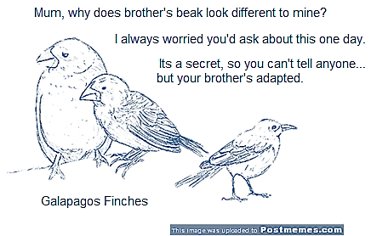
Question 8
(2)
Speciation is the evolutionary process by which new biological species arise.
Name the two types of speciation and how they occur.

Slide 10
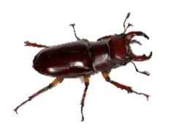
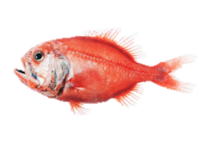
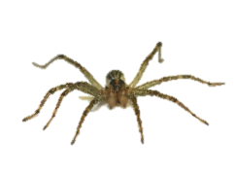
Question 9
(1)
The wolf, water, zebra and swamp are species of which animal?
Beetle
Fish
Spider
Orchid
Biology Challenge

Slide 11
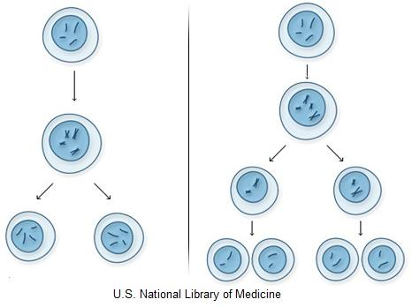
Question 10
(2)
Name the two processes through which cells divide.
Contributed by the Biochemical Society

Slide 12
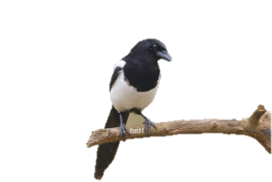
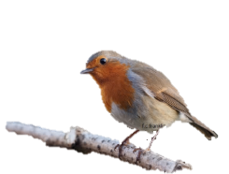
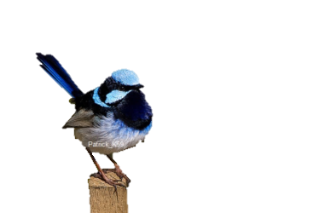
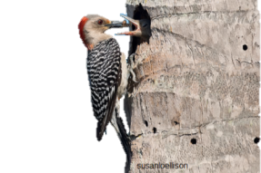
Question 11
(1)
Which bird makes this call?
European Robin
Eurasian Magpie
Superb Fairy-Wren
Red-bellied Woodpecker
Eurasian Magpie
European Robin
Red-bellied Woodpecker
Superb Fairy-Wren

Slide 13
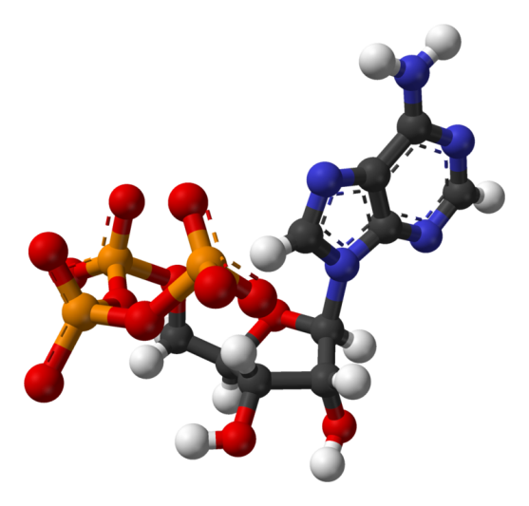
Question 12
(2)
What does ATP stand for?
What kind of cellular transport is ATP involved in?

Slide 14
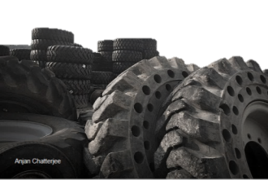
Question 13
(1)
TRUE/FALSE: When penetrating a rice leaf, rice blast fungus generates greater air pressure than inside a car tyre.
Contributed by the British Society for Plant Pathology

Slide 15
Question 14
(5)
What type of animal are the following famous on-screen characters?
Beethoven
Sven
Nermal
Sonic
Charlotte

Slide 16
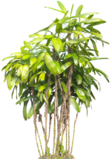
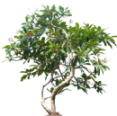
Question 15
(1)
Match the following terms with their definitions.
Succession
Climax community
Pioneer species
Abiotic environment
The first species to colonise an area
A stable, mature ecosystem at the end stage of succession
Non-living chemical and physical parts of an ecosystem
Process by which the structure of a biological community evolves over time

Slide 17
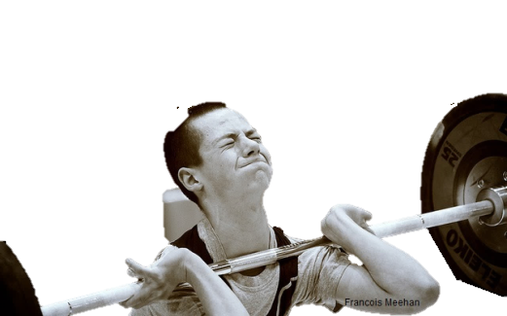
Question 16
(2)
Actin and myosin interactions are responsible for cell movement, including muscle contraction.
Briefly describe the basic structure of both actin and myosin.

Slide 18
Question 17
(1)
Identify this species of animal:
Even-toed ungulate
Characteristic coat pattern
Heart can be 2ft long and up to 11kg heavy
Communicate over long distances by infrasound
Not confident swimmers
Blue tongue

Slide 19
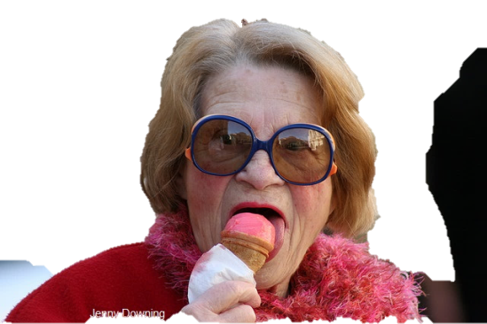
Question 18
(1)
What are the six proposed basic tastes that our tongue can detect?
Contributed by Oxford University Press

Slide 20
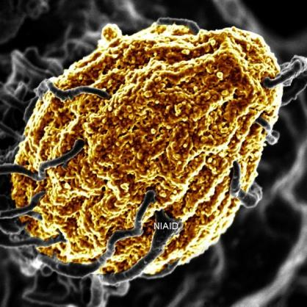
Question 19
(2)
Phagocytes are involved in the immune response; what are phagocytes and what do they do?

Slide 21
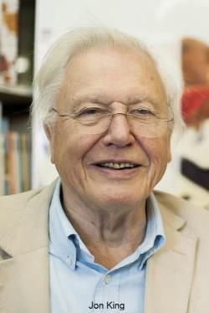
Question 20
(1)
Which animal would Sir David Attenborough most like to be?
Seahorse
Sloth
Slow worm
Siberian tiger
Salamander

Slide 22
How did you do? Scores out of /40
Tweet @RoyalSocBio using #BiologyWeek
Love biology? Interested in becoming a member?
Email membership@rsb.org.uk
Thank you for helping us celebrate Biology Week 2015!

