Slide 1
Biology Week 2016 Quiz Ages 13-15

Slide 2
1. What is the scientific study of plants known as?

Slide 3
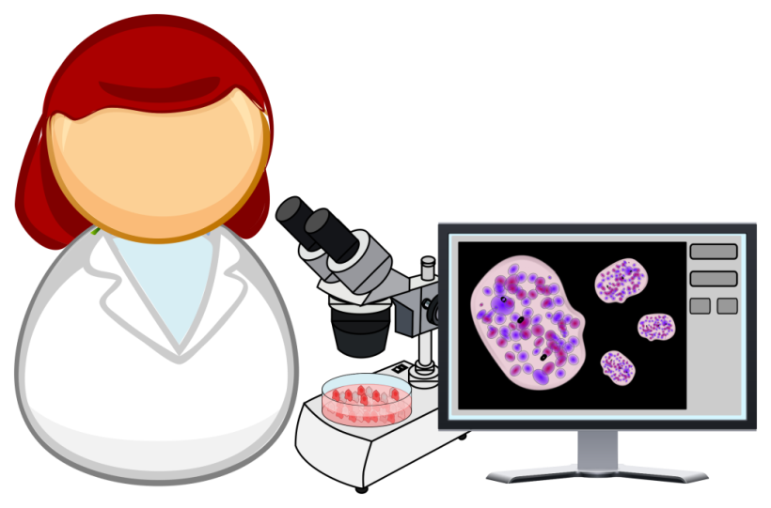
2. Which of the following cannot be seen under a light microscope?
Virus
Bacterium
Cell
Question contributed by the Society for Applied Microbiology

Slide 4
3. Can all bees sting?
Question contributed by The University of Gloucestershire.

Slide 5
4. Who discovered penicillin and how?
Question contributed by the Biochemical Society

Slide 6
5. The trachea, lungs and diaphragm are part of which system?
Circulatory system
Respiratory system
Digestive system
Question contributed by The Physiological Society

Slide 7
6. How many different species pollinate UK plants?
(A) 15
(B) 150
(C) 1500
Question contributed by the British Ecological Society

Slide 8
7. Bacteria are really ______, they are made of a ______ ______ . You can find bacteria ______. Some bacteria live inside you and don’t harm you. Examples of places they live include your ______ and your ______. Other bacteria are harmful. When they grow in places they shouldn’t, they cause ______.
Fill in the gaps using the following words: intestines, cell, nose, small, everywhere, disease, single
(One mark for each correctly filled gap)
Question contributed by the Microbiology Society

Slide 9
8. What percentage of a bacterial cell is water?
70%
95%
50%
35%
Question contributed by the Biochemical Society

Slide 10
9. Approximately how much of our DNA is the same as that of a banana?
60%
70%
10%
25%
Question contributed by the Biochemical Society

Slide 11
10. What is the normal internal temperature of the human body?
(A) 27°C
(B) 35°C
(C) 37°C

Slide 12
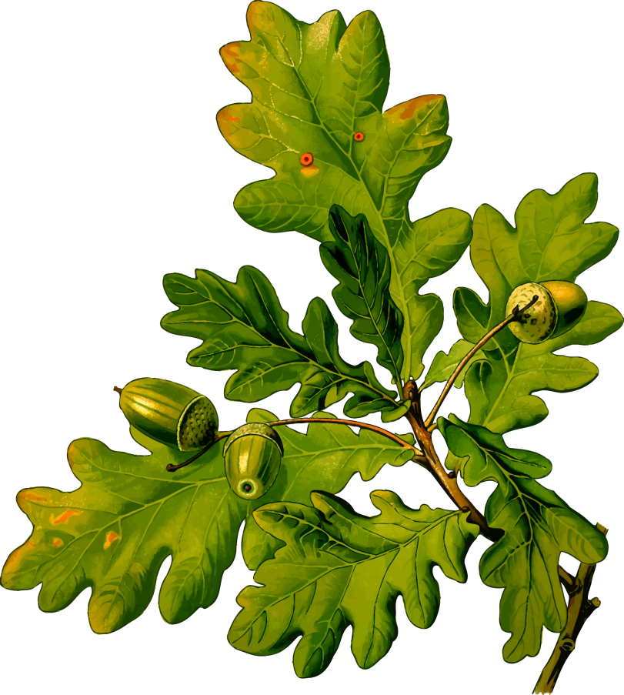
11. How old is the average English (common) oak tree when it produces its first acorns (i.e. reproduces)?
(A) 4 years
(B) 40 years
(C) 400 years
Question contributed by the British Ecological Society

Slide 13
12. The thymus, spleen and lymph nodes are components of the:
Digestive system
Cardiac system
Immune system
Reproductive system
Question contributed by the British Society for Immunology

Slide 14
13. What is the lifespan of a starfish?
(A) 0-3 years
(B) 3-10 years
(C) 10-30 years
Question contributed by the Marine Biological Association

Slide 15
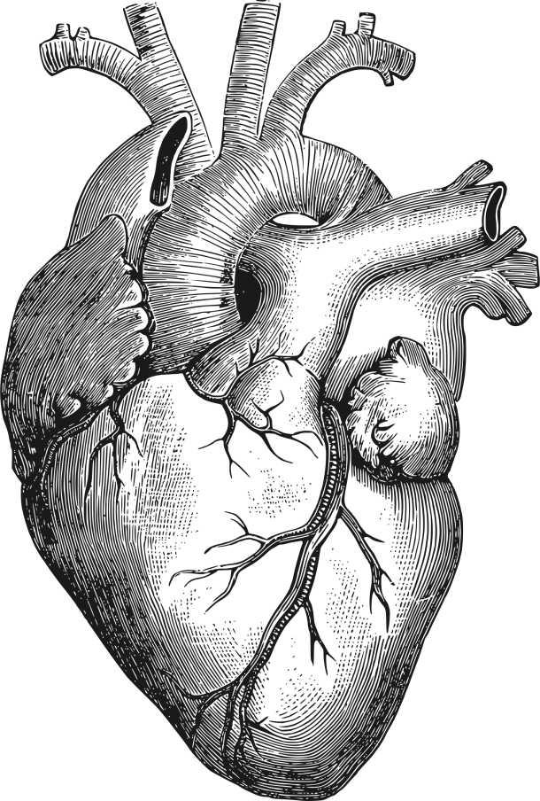
14. Which ventricle of the heart is larger and why?

Slide 16
15. Which organelles in animal cells have DNA?
Nucleus and mitochondria
Chloroplasts and mitochondria
Endoplasmic reticulum and nucleus
Endoplasmic reticulum, nucleus and mitochondria
Question contributed by the British Society for Immunology

Slide 17
21
How did you do?
Follow us on Twitter @RoyalSocBio tweet #BiologyWeek
Find us on Facebook too!
Love biology? Interested in becoming a member?
Email membership@rsb.org.uk
Thank you for helping us celebrate Biology Week 2016!

