Slide 1
The Royal Society of Biology and you
{insert name and grade}
Accurate as of October 2016
Notes:
OPENING
{insert name and grade}

Slide 2
What is a professional body?
‘An organisation created to promote and support an academic discipline or profession, or a group of related disciplines or professions’
Notes:
FIRSTLY, WHAT IS A PROFESSIONAL BODY?
- We support the biosciences and your future within it

Slide 3
Welcome to the Royal Society of Biology
Notes:
WELCOME TO THE ROYAL SOCIETY OF BIOLOGY

Slide 4
Our vision is of a world that understands the true value of biology and how it can contribute to improving life for all Our mission is to;
Be the unifying voice for biology
Facilitate the promotion of new discoveries in biological science for national and international benefit
Engage the wider public with our work
Notes:
WHAT WE STAND FOR
Our vision and mission

Slide 5
Our Individual Members include: Our Organisational Members are other life sciences membership organisations and companies. They also support us to be the unifying voice of biology.
Nobel Laureates.
Students at all levels.
Life sciences professionals in academia, industry, education and policy.
Anyone else with an interest in biology.
Notes:
OUR MEMBERSHIP
We have over 17,000 Individual Members and 100 Organisational Members across the country… and world!

Slide 6
How can we support you?
Notes:
HOW CAN WE SUPPORT YOU?

Slide 7
YOU
Strengthen your CV
Funding and discounts
Network
Discover
Life after your degree
Notes:
AS A MEMBER, THESE ARE THE 5 WAYS YOU CAN ENGAGE WITH US

Slide 8
Strengthen your CV
Notes:
STRENGTHEN YOUR CV

Slide 9
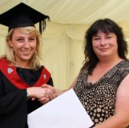
Competitions and Awards
The Top Student Award rewards the achievements of outstanding undergraduate biologists by publicly recognising their skills and abilities.
The Photography Competition is themed every year. Applicants can win a prize of £1000 and are presented with their award at our annual awards ceremony
Notes:
ENTER A COMPETITION OR APPLY FOR AN AWARD
Check online for further details

Slide 10
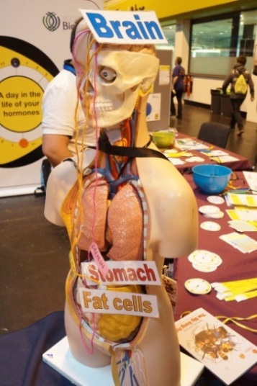
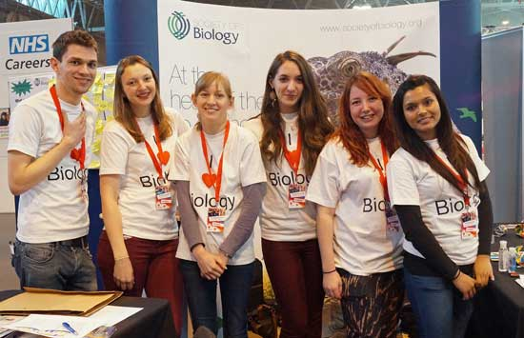
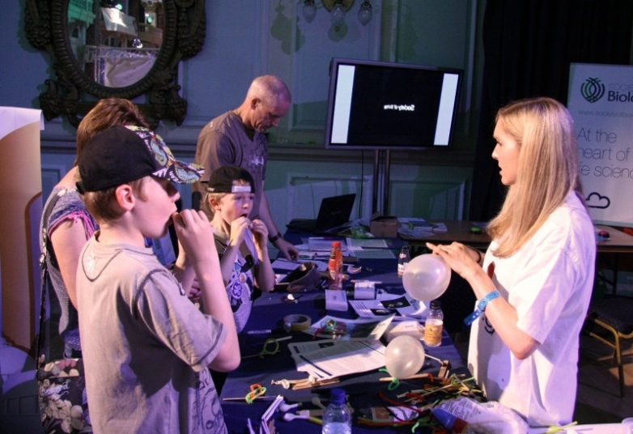
Volunteer in Public Engagement
Science Festivals
Big Biology Days
Bioblitz
Regional Branch Events
penny.fletcher@rsb.org.uk
www.rsb.org.uk/biologyweek
Notes:
VOLUNTEER IN PUBLIC ENGAGEMENT
Volunteer with the Society at a range of science fairs and festivals round the country, contact Penny to express your interest.
Biology Week showcases the important and amazing world of the biosciences, getting everyone from children to professional biologists involved in fun and interesting life science activities – get involved creating or setting up an event! See the website for ideas.

Slide 11
Funding and discounts
Notes:
FUNDING AND DISCOUNTS

Slide 12
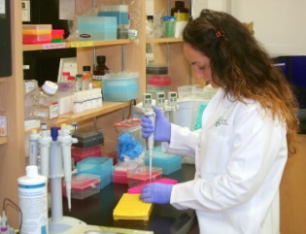
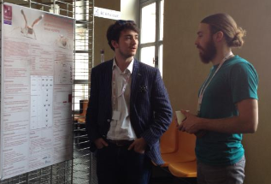
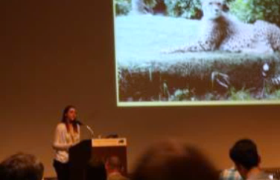
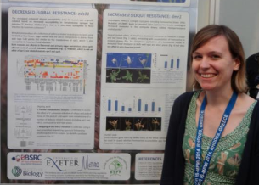
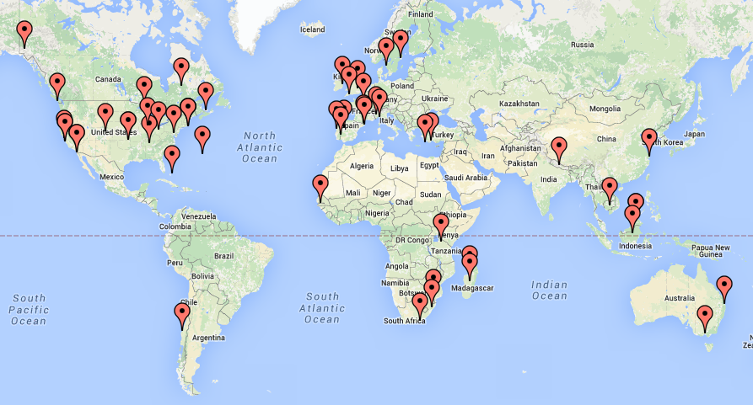
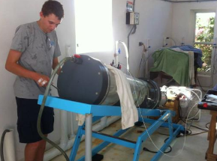
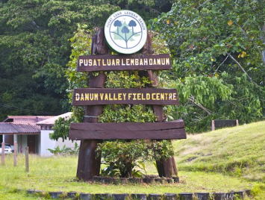
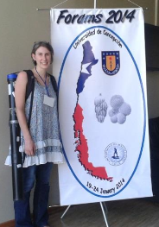
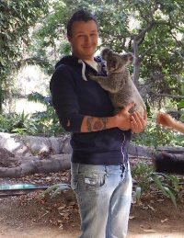
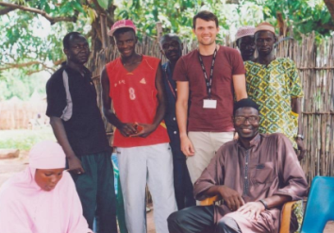
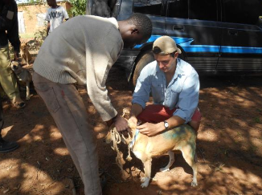
Grants for overseas travel in connection with biological study, teaching or research
Notes:
TRAVEL GRANTs
£500 grant for overseas travel in connection with biological study, teaching or research for those who would otherwise be unlikely to have it. There are 2 categories.
Student affiliate and AMRSB members.
MRSB members in the early stages of their research careers (0-10 years in paid employment) only.

Slide 13
Regional Grant Scheme
Funding and discounts
Regional Grants of between £50 - £500 help members run an event or activity in their region that engages members and the local community with biology
Notes:
REGIONAL GRANT SCHEME
If you have an idea for an event and are looking for some additional funds to help make it a success, you can apply for either a small grant of £50 - £200 or a full grant of £201 - £500.

Slide 14
Funding and discounts
20% discount on all life science titles from leading academic publishers:
Notes:
BOOK DISCOUNTS
Students receive an exclusive 20% discount on all life science titles from leading academic publishers wiley-blackwell and oxford university press.

Slide 15
Network
Notes:
NETWORK

Slide 16
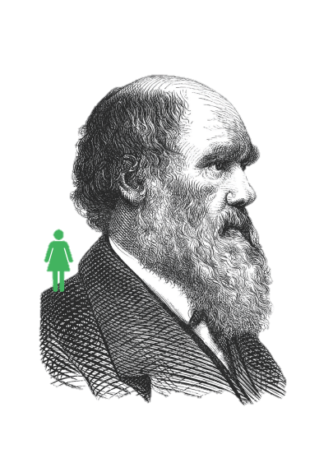
Join your professional network
Members include your lecturers, as well as your future colleagues and employers.
They may hold your next work experience opportunity or help give you insight into working in academia, industry or education
Notes:
JOIN YOUR PROFESSIONAL NETWORK
Meeting other like-minded members, who are involved in academia, industry and education, and could give you an insight into your future career.

Slide 17
Discover
Notes:
DISCOVER

Slide 18
E-newsletters
Science Policy
Membership
Education (schools)
Industry
Higher Education
BioNet (14-19 year olds)
Training & Personal Development
Notes:
TOPICAL NEWSLETTERS
Stay up to date with the latest science policy developments with our weekly science policy newsletter, a concise breakdown on what has happened from health and biomedicine to environment and ecology, from government and parliament to research funding policy.
Subscribe to our other monthly newsletters to receive news, events, the latest grants, competitions & awards.

Slide 19
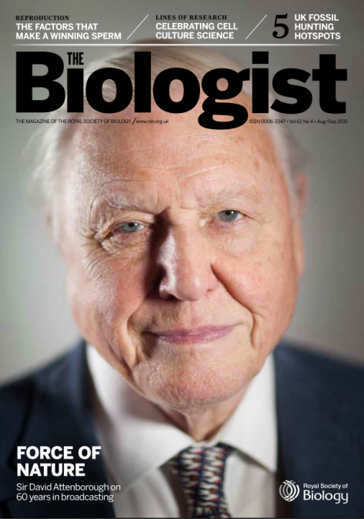
Discover
Award-winning bi-monthly magazine bringing the full richness and diversity of biology to life
RSB Blog
http://blog.rsb.org.uk
Notes:
THE BIOLOGIST
Student affiliate members of the Society receive a free subscription to our bimonthly peer reviewed magazine The Biologist. Biology is brought to life through an impressive range of review articles, whilst topical pieces discuss science policy, new developments or controversial issues.
Like the New Scientist of Biology, looking at areas of the life sciences you may not have covered since school!
RSB BLOG
Read about all the fascinating areas of the life sciences in our blog, and if you’re doing something really interesting, you might be able to write for it too! Contact media@rsb.org.uk with your idea.

Slide 20
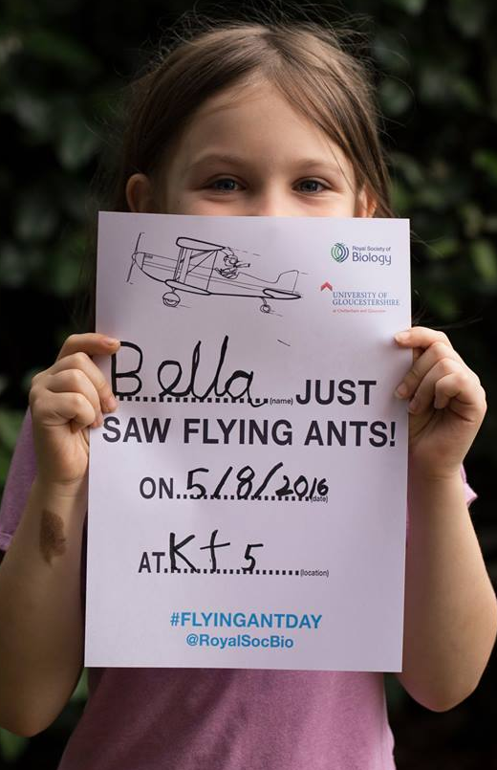
Citizen Science
Engage the Public
Notes:
CITIZEN SCIENCE
Starlings often form large groups and undertake spectacular aerial displays known as murmurations. Little is known about why this occurs. Our starling survey aims to address the murmuration mystery using potentially a very large dataset, provided by people across the UK.
Over three years we received over 10,000 records for our Flying Ant Survey, which helped researchers investigate why ants appear to take flight at exactly the same time every summer
#BritainBreathing is an exciting new citizen science project that aims to engage a wide range of the UK population to act as ‘citizen sensors’ to help scientists understand more about seasonal allergies such as hayfever or asthma

Slide 21
Key Policy Areas
Biomedical Sciences
Environmental and Ecosystem Science
Agriculture and Plant Science
Science in Parliament
Research Environment and Practice
Equality and Diversity
Biology Education in the UK
Notes:
KEY POLICY AREAS
Find out what’s happening in all of these different areas of the life sciences

Slide 22
Life after your degree
Notes:
LIFE AFTER YOUR DEGREE

Slide 23
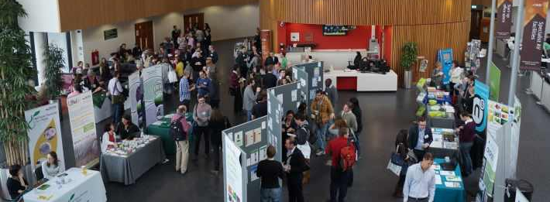
Notes:
BIOSCIENCE CAREERS FESTIVAL
Just £5
Hear experts give top tips on exciting careers available to you with a biological degree
Book a mock interview to sharpen your technique for future employers
Network with biology professionals and other students from across the UK
Watch science communicators live on stage & meet them afterwards
Meet representatives from a variety of top organisations in our exhibition and ask them informal questions over lunch
Delve into the biological collections at King's College London's on-site museums

Slide 24
Careers resources
www.rsb.org.uk/careers
Notes:
Student of the year
Life Sciences Conference

Slide 25
Our jobs board
http://jobs.rsb.org.uk
Notes:
OUR JOBS BOARD
Check online for new job opportunities

Slide 26
Join as a student affiliate for just £15 a year!
Notes:
JOIN AS A STUDENT AFFILIATE FOR JUST £15 A YEAR
Fill in the form and hand back to me, {which you can download here www.rsb.org.uk/toolkit }

Slide 27
Join your Professional Association
Support your career
Become a member of the Royal Society of Biology
Notes:
SO, PLEASE DO JOIN YOUR PROFESSIONAL ASSOCIATION, SUPPORT YOUR CAREER AND BECOME A MEMBER OF THE ROYAL SOCIETY OF BIOLOGY
{insert your email address}

