Slide 1
is the UK’s leading professional association for the life sciences representing a single unified voice for biology
The Royal Society of Biology…
represents and supports a diverse membership of 18,000 individuals, 90 learned societies and other organisations in the life sciences
www.rsb.org.uk/join

Slide 2
As an organisation, the Royal Society of Biology works to…
Advise government and influence policy
Advance education and professional development
Engage and encourage public interest in the life sciences
Support people working in the life sciences
www.rsb.org.uk/join
Notes:
Education, CPD – learning for life

Slide 3
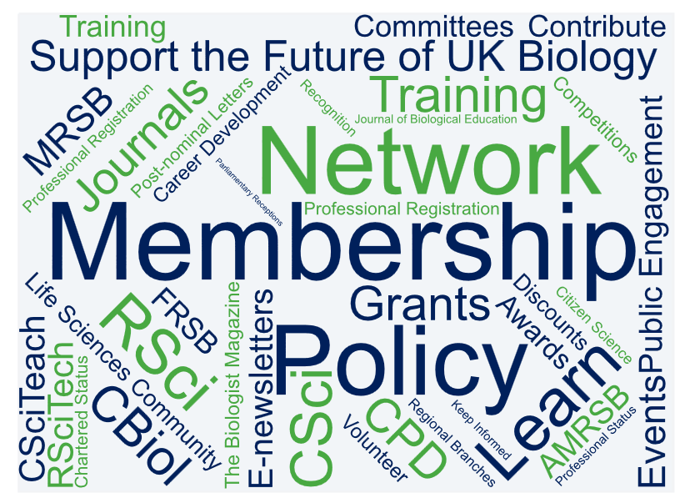
As a member of the Royal Society of Biology, you can…
www.rsb.org.uk/join

Slide 4
Join your Professional Association
Support the Life Sciences
Become a member of the Royal Society of Biology
www.rsb.org.uk/join
www.rsb.org.uk/join

